Slide 1

Flip Robo Technologies: Internship Batch 34
HOUSING: PRICE PREDICTION

Slide 2
1. INTRODUCTION

Slide 3
INTRODUCTION
What Is the House Price Index (HPI)?
The House Price Index (HPI) is a broad measure of the movement of single-family property prices in the United States. Aside from serving as an indicator of house price trends, it also functions as an analytical tool for estimating changes in the rates of mortgage defaults, prepayments, and housing affordability.1
KEY TAKEAWAYS
The House Price Index (HPI) is a broad measure of the movement of single-family house prices in the United States.
It is published by the Federal Housing Finance Agency (FHFA), using monthly and quarterly data supplied by Fannie Mae and Freddie Mac.
The HPI is one of many economic indicators that investors use to keep a pulse on broader economic trends and potential shifts in the stock market.

Slide 4
HPI PREDICTION
Fannie Mae
Freddie Mac
Should I offer the full asking price?
What brings down the value of a house?

Slide 5
HOUSING MARKET PREDICTIONS FOR 2023
As we enter 2023, housing experts maintain a watchful eye on the economy, which is still being pulled in all directions by high inflation, steep interest rates, ongoing geopolitical uncertainties and recession fears, to name a few.
After a couple of red-hot years for the housing market, there are indicators a correction is underway—but it’s been slow-going. Mortgage rates are still hovering around double what they were a year ago. And nationwide home prices are still increasing on a monthly basis despite a decline in total sales. This continues to make it harder for many homebuyers to access affordable housing.
The median existing-home sales price was up 3.5% to $370,700 in November compared to a year ago, according to the National Association of Realtors (NAR). It was the 129th consecutive month of YOY price increases—a record streak—even though home prices have fallen from their record high of $413,800 in June.

Slide 6
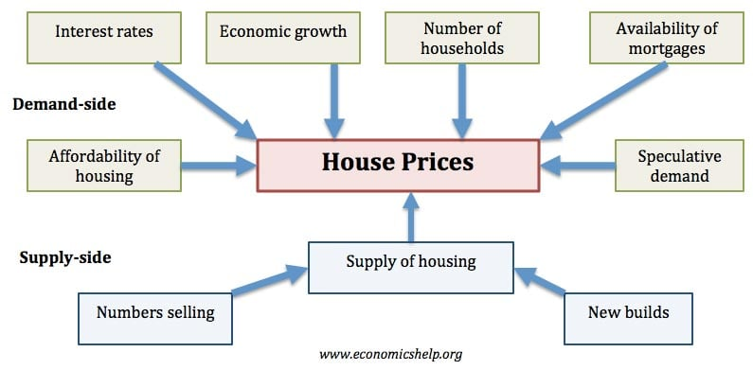
FACTORS THAT AFFECT THE HOUSING MARKET

Slide 7
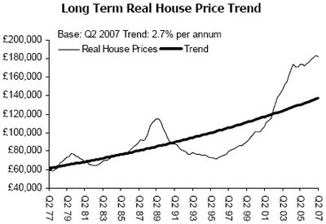
WHY BOOM AND BUSTS ARE COMMON?

Slide 8
WHY BOOM AND BUSTS ARE COMMON?
01
02
03
04
Interest Rates
Time Delays in Building House
Confidence Factor
Mortgage Industry is cyclical

Slide 9
RESEARCH OBJECTIVES
This research paper has the following objectives:
For this company wants to know:
• Which variables are important to predict the price of variable?
• How do these variables describe the price of the house?
Business Goal:
You are required to model the price of houses with the available independent variables.

Slide 10
RESEARCH METHODOLOGY
RESEARCH DESIGN
The research design is the conceptual framework around which the survey is undertaken. Here a part of the research undertaken is a Exploratory Research as it is describing the perception of the respondents.
SAMPLE SIZE
The Sample Size is 1460. Data has been collected and analysed on the basis of the responses. The research was conducted with an aim of getting respondents from all across USA.

Slide 11
RESEARCH METHODOLOGY
PERIOD OF STUDY
The period of study was more than a week.
DATA COLLECTION
Primary Data- Dataset and Data description provided by Flip Robo technologies for project completion.
Secondary Data-The data includes reference from previously published research papers, journals, books and articles.
METHOD OF ANALYSIS
In this research, tables and various types of graphs such as bar graph and count plot have been used. This helped to present the data in a meaningful way and making it easily understandable. We will use LINEAR REGRESSION MODEL TO PREDICT THE HOUSE PRICE FOR TEST.CSV DATA.

Slide 12
2. STEPS USED IN PREDICTING HOUSE PRICE

Slide 13
2.1 Choosing the model

Slide 14
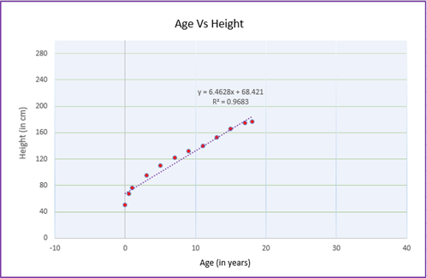
We will use LINEAR REGRESSION MODEL:
Linear regression is a machine learning algorithm which estimates how a model is following a linear relationship between one response variable (denoted by y) and one or more explanatory variables (denoted by X1, X2, X3…. Xn). The response variable will dependent on how the explanatory variables changes and not the other way round. Response variable is also known as target or dependent variable while the explanatory variable is known as independent or predictor variables.

Slide 15
2.2 Steps used in EDA & Preprocessing

Slide 16
Steps:
1. Identification of variables and data types
2. Analyzing the basic metrics
3. Non-Graphical Univariate Analysis
4. Missing value treatment
5. Graphical Univariate Analysis
6. Bivariate Analysis
7. Encoding the categorical Data
8. Outlier treatment
9. Variable transformations
10. Correlation Analysis
11. Dimensionality Reduction
12.Scaling of Independent features

Slide 17
2.3 Steps used in the Project

Slide 18
Steps:
1. We need to apply feature engineering/ EDA on the dataset. After that you can split the dataset into train_model and test_model; use this train_model to train your model and test_model to validate your model.
2. After splitting the dataset you need to train at least 4-5 models.
3. Check performance of each model
For regression problem- create regression model and check the r2 score and metrics of each model .
4. Check the cross validation score for each model(for classification as well as for regression model).
5. Choose the model as the best model.
For regression problem- model with least difference between performance parameter and cross validation computed on same performance parameter is the best model. Example- Difference between r2 score and cross validation computed on r2 scoring parameter.
6. Perform hyper parameter tuning on the best model and check performance of the best model.
7. Save the best model.

Slide 19
3. ANALYSIS: DATA FINDINGS AND INTERPRETATION

Slide 20
3.1 Data shapes and Data types

Slide 21
Shape of DataFrame:
The shape property returns a tuple containing the number of rows and columns of the DataFrame.
Data Types:
Pandas dtype mapping
Pandas dtype | Python type | NumPy type | Usage
object | str or mixed | string_, unicode_, mixed types | Text or mixed numeric and non-numeric values
int64 | Int | int_, int8, int16, int32, int64, uint8, uint16, uint32, uint64 | Integer numbers
float64 | Float | float_, float16, float32, float64 | Floating point numbers
bool | Bool | bool_ | True/False values
datetime64 | NA | datetime64[ns] | Date and time values
timedelta[ns] | NA | NA | Differences between two datetimes
category | NA | NA | Finite list of text values

Slide 22
3.2 Data Visualization We will use countplot for catagorial data and distplot for continuous data. Also, we will drop the Id column to avoid confusion and errors.

Slide 23
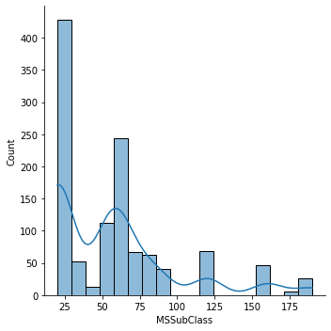
MSSUBCLASS-
Here, we see that 25 has the highest count in our dataset.

Slide 24
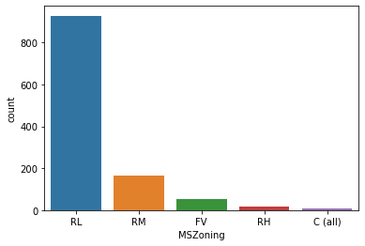
MSZONING-
RL 928
RM 163
FV 52
RH 16
C (all) 9
Here, we see that RL has the highest count which represents Residential Low Density.

Slide 25
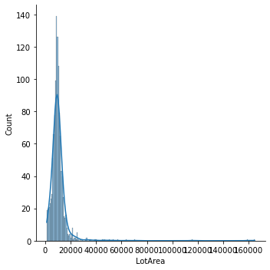
LOTAREA-
Here, we see that Lot Area is mainly in between 10000 to 20000 square feet.

Slide 26
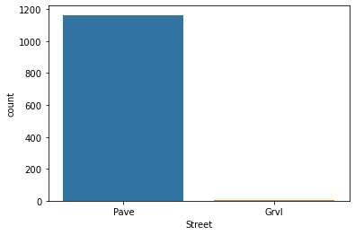
STREET-
Pave 1164
Grvl 4
We see that maximum houses have Pave style streets.

Slide 27
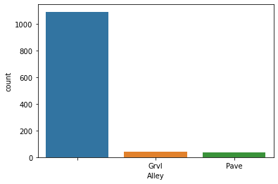
ALLEY-
1091
Grvl 41
Pave 36
Here, NA has the highest count which means maximum houses do not have an alley access.

Slide 28
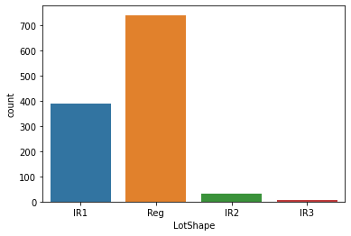
LOT SHAPE-
Reg 740
IR1 390
IR2 32
IR3 6
Here, Reg which represents Regular has the highest count..

Slide 29
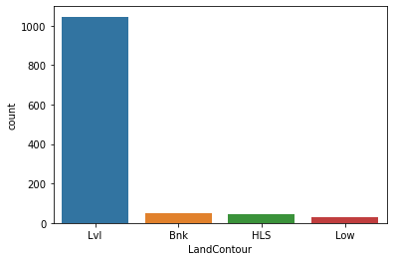
LAND CONTOUR-
Lvl 1046
Bnk 50
HLS 42
Low 30
Here, we see that Lvl has the highest count which represents Near flat/Level.

Slide 30
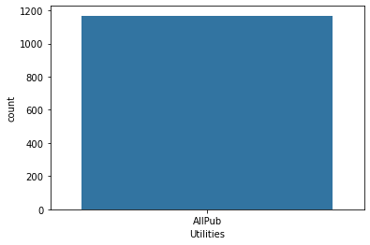
UTILITIES-
AllPub 1168
Here, all the houses have all public utilities access like Electricity, Gas, Water and Sewage.

Slide 31
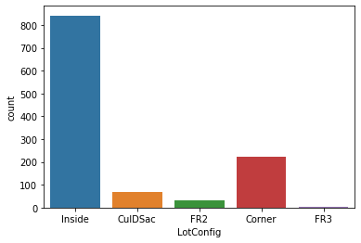
LOT CONFIG-
Inside 842
Corner 222
CulDSac 69
FR2 33
FR3 2
Here, Inside which represents Inside Lot has the maximum count.

Slide 32
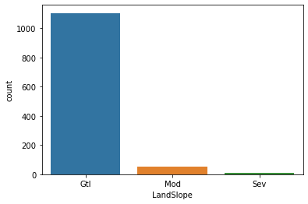
LAND SLOPE-
Gtl 1105
Mod 51
Sev 12
Here, Gtl which represents Gentle slope has the highest count.

Slide 33
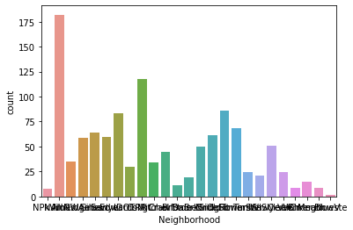
NEIGHBORHOOD-
NAmes 182
CollgCr 118
OldTown 86
Edwards 83
Somerst 68
Gilbert 64
NridgHt 61
Sawyer 60
NWAmes 59
SawyerW 51
BrkSide 50
Crawfor 45
NoRidge 35
Mitchel 34
IDOTRR 30
Timber 24
ClearCr 24
SWISU 21
StoneBr 19
Blmngtn 15
BrDale 11
MeadowV 9
Veenker 9
NPkVill 8
Blueste 2
Here, Nsmes which represents North Ames has the highest count.

Slide 34
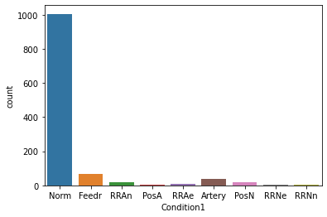
CONDITION 1- PROXIMITY TO VARIOUS CONDITIONS
Norm 1005
Feedr 67
Artery 38
RRAn 20
PosN 17
RRAe 9
PosA 6
RRNn 4
RRNe 2
Here we see that, Norm which represents Normal has the highest count.

Slide 35
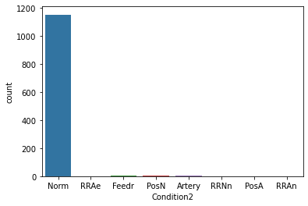
CONDITION 2- PROXIMITY TO VARIOUS CONDITIONS (IF MORE THAN ONE IS PRESENT)
Norm 1154
Feedr 6
PosN 2
Artery 2
RRAe 1
RRNn 1
PosA 1
RRAn 1
Here we see that, Norm which represents Normal has the highest count.

Slide 36
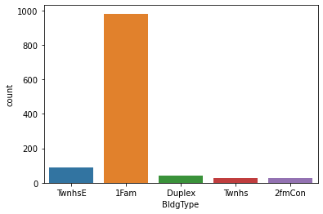
BLDG TYPE- TYPE OF DWELLING
1Fam 981
TwnhsE 90
Duplex 41
Twnhs 29
2fmCon 27
Here we see that, 1Fam which represents Single family detached has the highest count.

Slide 37
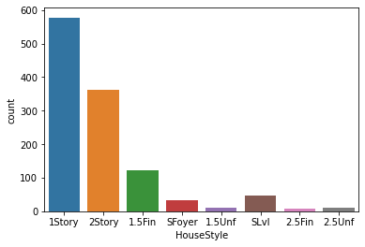
HOUSE STYLE-
1Story 578
2Story 361
1.5Fin 121
SLvl 47
SFoyer 32
1.5Unf 12
2.5Unf 10
2.5Fin 7
Here we see that, maximum houses of our dataset is 1 Story .

Slide 38
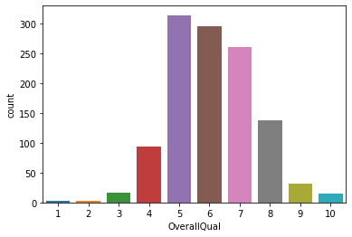
OVERALL QUALITY- RATES THE OVERALL MATERIAL AND FINISH OF THE HOUSE
5 314
6 295
7 260
8 138
4 93
9 32
3 16
10 15
2 3
1 2
Here we see that, maximum houses of our dataset are rated as Average.

Slide 39
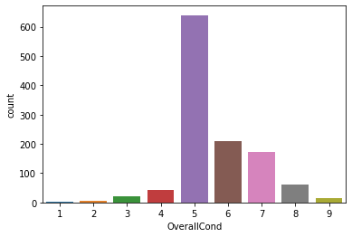
OVERALL CONDITION-
5 640
6 209
7 172
8 61
4 43
3 21
9 16
2 5
1 1
Here we see that, maximum houses of our dataset is rated as Average.

Slide 40
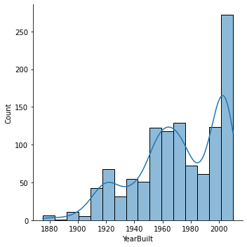
YEAR BUILT-
Here we see that, maximum houses of our dataset were built after the year 2000.

Slide 41
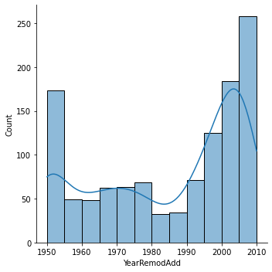
YEAR REMOD ADD-
Here we see that, maximum houses of our dataset were remodelled between 2000 to 2010.

Slide 42
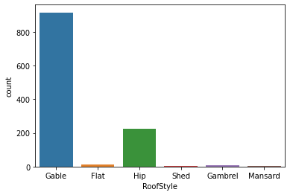
ROOF STYLE-
Gable 915
Hip 225
Flat 12
Gambrel 9
Mansard 5
Shed 2
Here we see that, maximum houses of our dataset has a Gable roof.

Slide 43
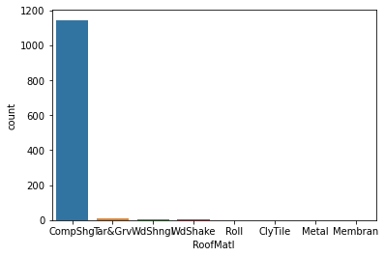
ROOF MATERIAL-
CompShg 1144
Tar&Grv 10
WdShngl 6
WdShake 4
Roll 1
ClyTile 1
Metal 1
Membran 1
Here we see that, maximum houses of our dataset has Standard composite shingle roof.

Slide 44
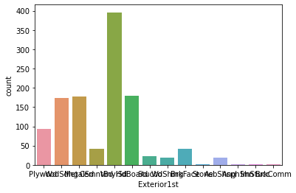
EXTERIOR 1ST -
VinylSd 396
HdBoard 179
MetalSd 178
Wd Sdng 174
Plywood 93
CemntBd 42
BrkFace 41
Stucco 22
WdShing 19
AsbShng 19
Stone 2
AsphShn 1
ImStucc 1
BrkComm 1
Here we see that, maximum houses are covered with Vinyl siding.

Slide 45
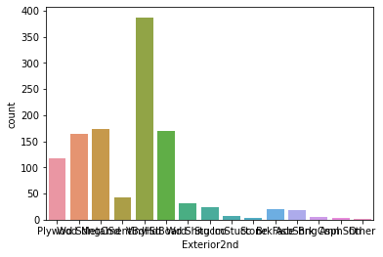
EXTERIOR 2ND -
VinylSd 387
MetalSd 173
HdBoard 170
Wd Sdng 165
Plywood 118
CmentBd 42
Wd Shng 31
Stucco 23
BrkFace 20
AsbShng 18
ImStucc 8
Brk Cmn 5
Stone 4
AsphShn 3
Other 1
Here we see that, maximum houses are covered with Vinyl siding.

Slide 46
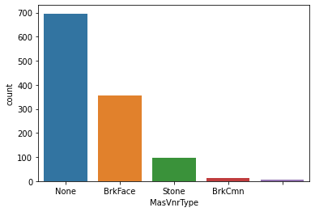
MASONRY VENEER TYPE-
None 696
BrkFace 354
Stone 98
BrkCmn 13
7
Here we see that, maximum houses of our dataset do not have a masonry veneer type.

Slide 47
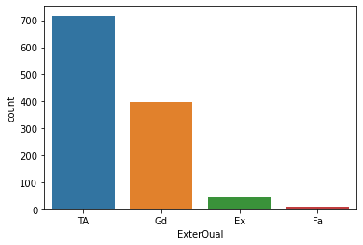
EXTERIOR QUALITY-
TA 717
Gd 397
Ex 43
Fa 11
Here we see that, maximim houses of our dataset have Average/ Typical exteriors.

Slide 48
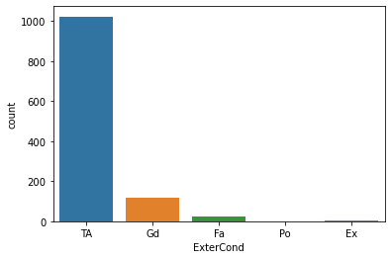
EXTERIOR CONDITION-
TA 1022
Gd 117
Fa 26
Ex 2
Po 1
Here we see that, maximum houses of our dataset have Average/ Typical exterior conditions.

Slide 49
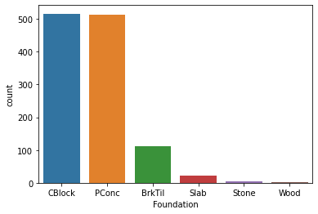
FOUNDATION-
CBlock 516
PConc 513
BrkTil 112
Slab 21
Stone 5
Wood 1
Here we see that, maximum houses of our dataset have a Cinder block foundation.

Slide 50
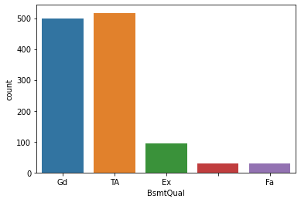
BASEMENT QUALITY-
TA 517
Gd 498
Ex 94
30
Fa 29
Here we see that, maximum houses of our dataset have Typical (80-90 inches) of basement height.

Slide 51
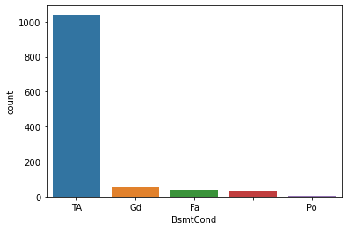
BASEMENT CONDITION-
TA 1041
Gd 56
Fa 39
30
Po 2
Here we see that, maximum houses of our dataset have Typical with slight dampness allowed kind of basements.

Slide 52
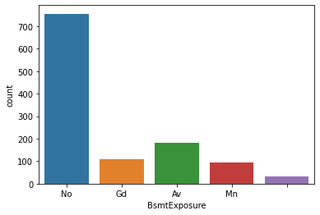
BASEMENT EXPOSURE-
No 756
Av 180
Gd 108
Mn 93
31
Here we see that, maximum houses of our dataset have no basement exposure which refers to walkout or garden level walls.

Slide 53
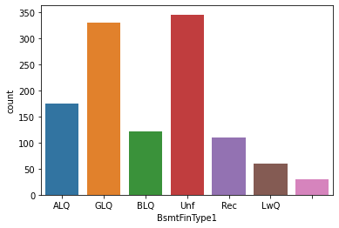
BASEMENT FINISHED TYPE 1-
Unf 345
GLQ 330
ALQ 174
BLQ 121
Rec 109
LwQ 59
30
Here we see that, maximum houses of our dataset have unfinished basements.

Slide 54
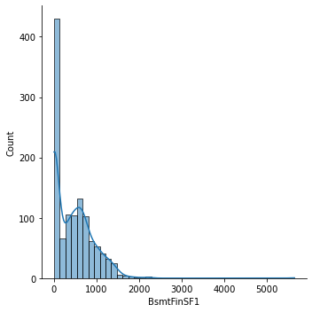
BASEMENT FINISHED TYPE 1 SQFT.-
Here we see that, maximum basement areas are between 500 to 1200 sqft.

Slide 55
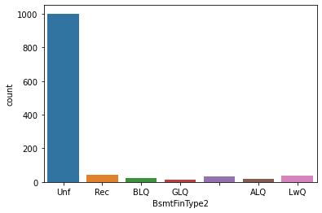
BASEMENT FINISHED TYPE 2-
Unf 1002
Rec 43
LwQ 40
31
BLQ 24
ALQ 16
GLQ 12
Here we see that, maximum basements are unfinished.

Slide 56
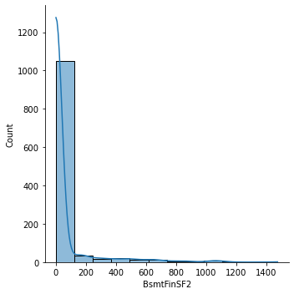
BASEMENT FINISHED TYPE 2 SQFT.-
Here we see that, maximum basements are between 100 to 500 sqft.

Slide 57
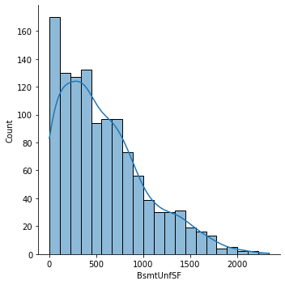
BASEMENT UNFINISHED SQFT.-
Here we see that, maximum unfinished basements have area of 400 to 1400 sqft.

Slide 58
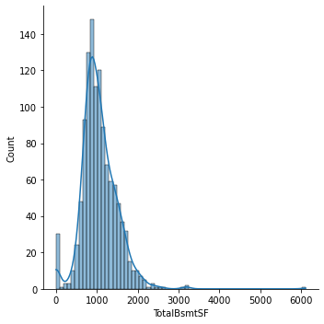
TOTAL SQFT. OF BASEMENT AREA-
Here we see that, total basement area is between 800 to 1700 sqft.

Slide 59
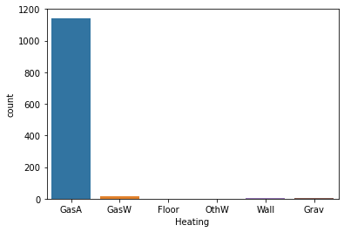
HEATING-
GasA 1143
GasW 14
Grav 5
Wall 4
Floor 1
OthW 1
Here we see that, maximum houses have heating of gas forced warm air furnance.

Slide 60
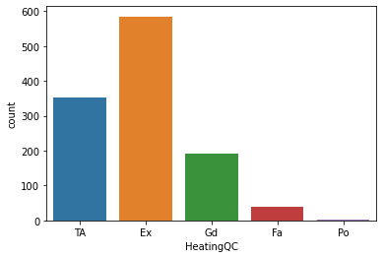
HEATING QUALITY AND CONDITION-
Ex 585
TA 352
Gd 192
Fa 38
Po 1
Here we see that, maximum houses have excellent heating quality and condition.

Slide 61
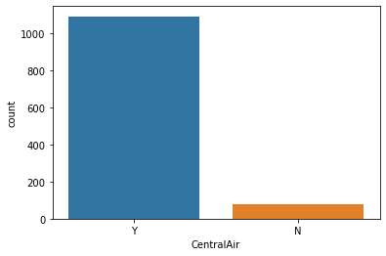
CENTRAL AIR CONDITIONING-
Y 1090
N 78
Here we see that, maximum houses of our dataset are centralized air conditioned.

Slide 62
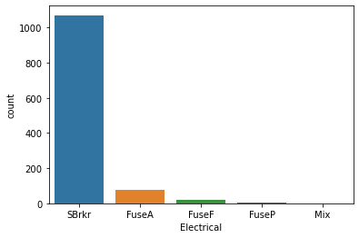
ELECTRICAL-
SBrkr 1070
FuseA 74
FuseF 21
FuseP 2
Mix 1
Here we see that, maximum houses have standard circuit breakers and romex.

Slide 63
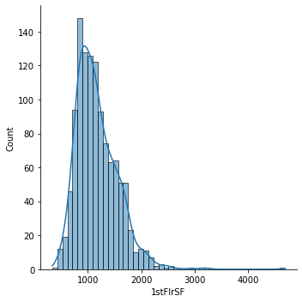
FIRST FLOOR SQFT.-
Here we see that, maximum houses have the first floor area between 900 to 1900 sqft.

Slide 64
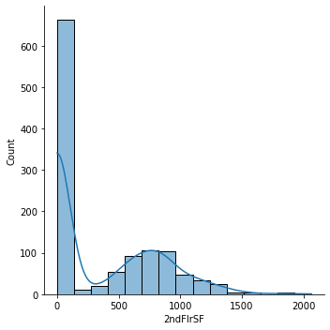
SECOND FLOOR SQFT.-
Here we see that, maximum houses have area of second floor between 500 to 900 sqft.

Slide 65
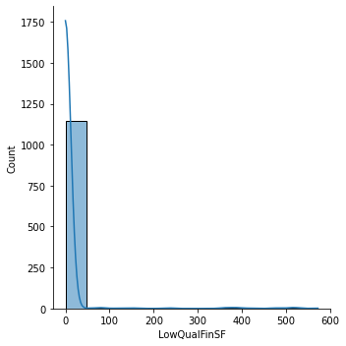
LOW QUALITY FINISHED SQFT.-
Here we see that, maximum houses do not have low quality finished area.

Slide 66
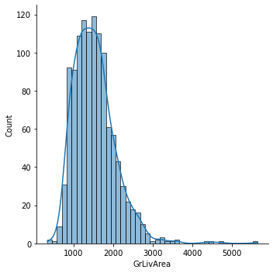
ABOVE GROUND LIVING AREA SQFT.-
Here we see that, maximum houses have an area between 1100 to 2500 sqft. of living area above ground.

Slide 67
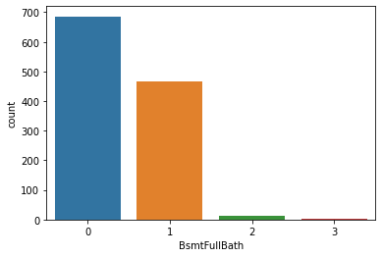
BASEMENT FULL BATHROOMS-
0 686
1 468
2 13
3 1
Here we see that, maximum houses of our dataset do not have a basement full bathroom..

Slide 68
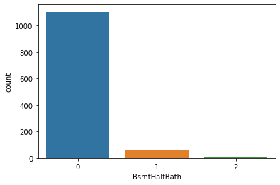
BASEMENT HALF BATHROOMS-
0 1105
1 61
2 2
Here we see that, maximum houses do not have a half basement bathroom.

Slide 69
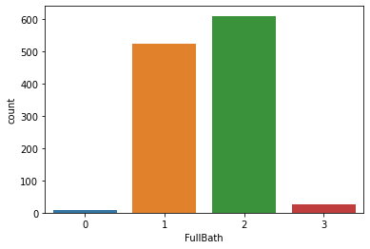
FULL BATHROOMS ABOVE GRADE-
2 610
1 524
3 27
0 7
Here we see that, maximum houses have 2 bathrooms above grade.

Slide 70

HALF BATHS ABOVE GRADE-
0 724
1 434
2 10
Here we see that, maximum houses do not have half bathrooms above grade.

Slide 71

BEDROOMS ABOVE GRADE-
3 640
2 281
4 180
1 39
5 18
6 5
0 4
8 1
Here we see that, most houses have 3 bedrooms above grade.

Slide 72

KITCHEN ABOVE GRADE-
1 1114
2 52
3 1
0 1
Here we see that, maximum houses have 1 kitchen above grade.

Slide 73

KITCHEN QUALITY-
TA 578
Gd 478
Ex 82
Fa 30
Here we see that, maximum houses have kitchen quality rated as average/typical.

Slide 74

TOTAL ROOMS ABOVE GRADE-
6 325
7 268
5 217
8 148
4 72
9 65
10 41
11 13
3 11
12 6
2 1
14 1
Here we see that maximum houses have 6 rooms above grade.

Slide 75

HOME FUNCTIONALITY-
Typ 1085
Min2 30
Min1 25
Mod 12
Maj1 11
Maj2 4
Sev 1
Here we see that, maximum houses have a typical functionality.

Slide 76

FIREPLACES-
0 551
1 518
2 94
3 5
Here we see that, most houses do not have a fire place.

Slide 77

FIREPLACE QUALITY-
551
Gd 301
TA 252
Fa 25
Ex 21
Po 18
Here we see that, most houses have no fireplace.

Slide 78

GARAGE LOCATION-
Attchd 691
Detchd 314
BuiltIn 70
64
Basment 16
CarPort 8
2Types 5
Here we see that, most houses have a garage attached to the home..

Slide 79

INTERIOR FINISH OF THE GARAGE-
Unf 487
RFn 339
Fin 278
64
Here we see that, maximum house have unfinished garage interiors.

Slide 80

SIZE OF GARAGE IN CAR CAPACITY-
2 665
1 288
3 147
0 64
4 4
Here we see that, maximum houses have a garage size to fit 2 cars.

Slide 81

GARAGE AREA-
Here we see that, most houses have a garage area between 400 to 600 sqft.

Slide 82

GARAGE QUALITY-
TA 1050
64
Fa 39
Gd 11
Ex 2
Po 2
Here we see that, maximum houses have a garage quality that is typical/ average.

Slide 83

GARAGE CONDITION-
TA 1061
64
Fa 28
Gd 8
Po 6
Ex 1
Here we see that, most houses have typical/ average condition of garage.

Slide 84

PAVED DRIVEWAY-
Y 1071
N 74
P 23
Here we see that, most houses have a paved driveway.

Slide 85

WOOD DECK AREA-
Here we see that, maximum wood deck area is between 100 to 250 sqft.

Slide 86

OPEN PORCH AREA-
Here we see that, most houses have open porch area between 40 to 150 sqft.

Slide 87

ENCLOSED PORCH AREA-
Here we see that, maximum houses have enclosed porch area is between 110 to 240 sqft.

Slide 88

THREE SEASON PORCH AREA-
Here we see that, most houses do not have a three season porch area.

Slide 89

SCREEN PORCH AREA-
Here we see that, most houses do not have a screen porch area.

Slide 90

POOL AREA-
Here we see that, maximum houses do not have a pool area.

Slide 91

POOL AREA QUALITY-
1161
Gd 3
Ex 2
Fa 2
Here we see that, maximum houses do not have a pool area.

Slide 92

FENCE QUALITY-
931
MnPrv 129
GdPrv 51
GdWo 47
MnWw 10
Here we see that, most houses do not have a fence.

Slide 93

MISCELLANEOUS FEATURES-
1124
Shed 40
Gar2 2
TenC 1
Othr 1
Here we see that, most houses do not fall under this category.

Slide 94

MISC. VALUE IN $-
1124
Shed 40
Gar2 2
TenC 1
Othr 1
Here we see that, most houses do not fall under this category.

Slide 95

MONTH SOLD-
Here we see that, maximum sales was done in the months of June and July.

Slide 96

YEAR SOLD-
Here we see that, maximum sales was don in the year 2007.

Slide 97

TYPE OF SALE-
WD 999
New 106
COD 38
ConLD 8
ConLI 5
ConLw 4
Oth 3
CWD 3
Con 2
Here we see that, maximum sales was done under the category of warranty deed- conventional.

Slide 98

SALE CONDITION-
Normal 945
Partial 108
Abnorml 81
Family 18
Alloca 12
AdjLand 4
Here we see that, most houses were sold under the normal condition.

Slide 99

SALE PRICE- TARGET COLUMN
Here we see that, most houses lie between the price range of 150000 to 300000 dollars.

Slide 100
FINDINGS:
For predicting the price of the house, the following variables are important:
MSSubclass
MSZoning
Lot frontage
Lot area
Street
Alley
Lot shape
Land contour
Utilities
Condition 1
Condition 2
Overall quality
Exterior 2nd
Central area
Electrical
Pool quality
Fence
Sale condition

Slide 101
3.3 ENCODING OF DATAFRAME

Slide 102
Encoding:
Encoding a dataframe means changing the data type of a particular column to the required type as the dataset demands. There are various types on Encoding techniques:
I. Classic Encoders
We started with the most basic techniques, classic encoders. As the name suggests, these encoders are well known and widely used. Their concept is also pretty straight-forward.
II. Contrast encoders
Contrast encoding allows for recentering of categorical variables such that the intercept of a model is not the mean of one level of a category, but instead, the mean of all data points in the data set.
III. Bayesian Target Encoders
The general idea of this method is to take the target into account.

Slide 103
3.4 DESCRIBING THE DATASET

Slide 104

Describing:
Describing the dataset gives us an understanding of various values like count of the attribute,mean of that attribute, standard deviation, minimum, 25th percentile, median/50th percentile, 75th percentile and the maximum value of that attribute.

Slide 105
3.5 CHECKING FOR OUTLIERS

Slide 106
Outliers and their removal:
An outlier is an object that deviates significantly from the rest of the objects. They can be caused by measurement or execution error. The analysis of outlier data is referred to as outlier analysis or outlier mining.
Algorithm:
Calculate the mean of each cluster
Initialize the Threshold value
Calculate the distance of the test data from each cluster mean
Find the nearest cluster to the test data
If (Distance > Threshold) then, Outlier

Slide 107
3.6 SEPARATING THE DATASET INTO FEATURES AND TARGET

Slide 108
Target and Features:
In order to make a prediction (in this case, whether a customer will recommend the e-commerce site to a friend or not), one needs to separate the dataset into two components:
the dependent variable or target which needs to be predicted
the independent variables or features that will be used to make a prediction
For dataset splitting we give the following command:
features=df.drop(‘SalePrice',axis=1)
target=df[‘SalePrice']

Slide 109
3.7 SCALING THE DATASET

Slide 110
Scaling:
Scaling is a method of standardization that’s most useful when working with a dataset that contains continuous features that are on different scales, and you’re using a model that operates in some sort of linear space (like linear regression or K-nearest neighbors)
We will use Min-Max scaling technique for our dataset.
Min-Max scaling, We have to subtract min value from actual value and divide it with max minus min. Scikit-Learn provides a transformer called MinMaxScaler. It has a feature_range hyperparameter that lets you change the range if you don’t want 0 to1 for any reason.
After this, we split the data into train and test data. We now check the training and testing accuracy using random state for loop for the range (0,100).
We now check the r2 score and handle overfitting and underfitting of the data.
Cross validation gives us the training and testing score, model accuracy and we do this using the CV mean using the for loop function.
We now draw the Best Fit line to represent the number of datapoints which shows good fit of our model. Equation of this line is : y=mx+c

Slide 111
3.8 REGULARIZATION OF THE DATASET

Slide 112
Regularization:
Regularization is one of the most important concepts of machine learning. It is a technique to prevent the model from overfitting by adding extra information to it.
Techniques of Regularization
There are mainly two types of regularization techniques, which are given below:
Ridge Regression
Lasso Regression
For our dataset, we use the Lasso Regression for regularization giving the following command:
from sklearn.model_selection import GridSearchCV
from sklearn.linear_model import Lasso
parameters={'alpha': [.0001, .001, .01, .1, 1, 10],
'random_state':list(range(0,10))}
ls=Lasso()
clf= GridSearchCV(ls,parameters)
clf.fit(features_train,target_train)
print(clf.best_params_)
We get an output stating: {'alpha': 0.0001, 'random_state': 0}
We now do the final model training using the above best parameters and get the test score as 93%

Slide 113
3.9 ENSEMBLE TECHNIQUE USED ON THE DATASET

Slide 114
Ensemble technique used:
Ensemble method in Machine Learning is defined as the multimodal system in which different classifier and techniques are strategically combined into a predictive model (grouped as Sequential Model, Parallel Model, Homogeneous and Heterogeneous methods etc.) Ensemble method also helps to reduce the variance in the predicted data, minimize the biasness in the predictive model and to classify and predict the statistics from the complex problems with better accuracy.
For our dataset, we use the Random Forest Regressor and get the output as:
{'criterion': 'mse', 'max_features': 'auto'}.
Now, we put the output and check the r2 and cross val score of the model. We get an output:
R2 Score: 87.63086012762095
Cross val score: 84.77104845915167
We are getting model accuracy above 87% and cross validation above 84% which shows our model is performing very good.

Slide 115
4. CONCLUSION AND FINDINGS

Slide 116
4.1 SAVING THE MODEL

Slide 117
Saving:
Pickle is a useful Python tool that allows you to save your ML models, to minimise lengthy re-training and allow you to share, commit, and re-load pre-trained machine learning models. Most data scientists working in ML will use Pickle or Joblib to save their ML model for future use.
We use the pickle.dump method to save the final model.

Slide 118
4.2 CONCLUSION

Slide 119
Conclusion:
To load a saved model from a Pickle file, all you need to do is pass the “pickled” model into the Pickle load() function and it will be deserialized. By assigning this back to a model object, you can then run your original model’s predict() function, pass in some test data and get back an array of predictions.
At the end, we load the saved model and check the predicted and original sales price of the houses.
We see that our model is performing very good with the accuracy score of above 87%.

Slide 120
5. BIBLIOGRAPHY

Slide 121
References:
https://pbpython.com/pandas_dtypes.html
https://www.datasciencemadesimple.com/encode-decode-column-dataframe-python/#:~:text=encode%20%28%29%20function%20with%20codec%20%E2%80%98base64%E2%80%99%20and%20error,be%20Decode%20a%20column%20of%20dataframe%20in%20python%3A
https://www.geeksforgeeks.org/machine-learning-outlier/
https://medium.com/pythoneers/z-distribution-or-z-score-application-in-machine-learning-fbba081cd9fe
https://www.investopedia.com/terms/h/house-price-index-hpi.asp
https://towardsdatascience.com/data-scaling-for-machine-learning-the-essential-guide-d6cfda3e3d6b
https://blog.finxter.com/the-complete-guide-to-min-max-scaler-in-machine-learning-with-ease/#:~:text=Min-Max%20scaling%20is%20a%20normalization%20technique%20that%20enables,range%20using%20each%20feature%E2%80%99s%20minimum%20and%20maximum%20value.
https://www.javatpoint.com/regularization-in-machine-learning
https://www.educba.com/ensemble-methods-in-machine-learning/
https://practicaldatascience.co.uk/machine-learning/how-to-save-and-load-machine-learning-models-using-pickle
https://www.forbes.com/advisor/mortgages/real-estate/housing-market-predictions/

Slide 122

THANK YOU!
PROJECT BY:-
Muskan Sureka
Internship Batch: 34

